Slide 1
BEYOND EARTH
Submitted in the partial fulfillment for the award of the degree of
BACHELOR OF ENGINEERING
IN
Big Data Analytics
Submitted by:
Ketan Nikumbh 20BCS4364
Burra Saiteja 20BCS3929
Durga Prasad 20BCS4386
Under the Supervision of:
Mrs. Shweta
Department of AIT-CSE
DISCOVER . LEARN . EMPOWER

Slide 2
Outline
Introduction to Project
Problem Formulation
Objectives of the work
Methodology used
Results and Outputs
Conclusion
Future Scope
References

Slide 3
INTRODUCTION
Limited Understanding of Asteroid Dynamics
Challenges in Characterizing Asteroid Resource Compositions
Technical and Operational Challenges in Resource Extraction
Risk Assessment and Planetary Defence Concerns
Balancing Resource utilization with Sustainability Goals
Space Mining for Resource Extraction

Slide 4
PROBLEM FORMULATION
Limited Trajectory Prediction Accuracy
Challenge of accurately predicting asteroid trajectories due to various factors
Complex Resource Distribution
Complexity of characterizing asteroid resource compositions and distributions
Technical Hurdles in Extraction
Present technical challenges in developing efficient and sustainable extraction technologies
Sustainability of Resources
Asteroid mining activities to ensure responsible and sustainable resource extraction practices

Slide 5
OBJECTIVES
Developing and Using RK-4 Model algorithm to analyze asteroid composition and trajectory data.
Identifying resource-rich asteroids and predict optimal mining paths.
Evaluate and compare the algorithm's performance through simulations and real-world data validation.
Provide insights into sustainable resource extraction strategies for future space missions.

Slide 6
METHODOLOGY
Data Acquisition: Gather asteroid composition and trajectory data from space missions like OSIRIS-REx and Hayabusa2.
Feature Engineering: Extract relevant features such as mineral composition, density, and orbital parameters.
Range Kutta-4 Model : Using differential model scaling for predicting Asteroid path.
Simulation and Validation: Evaluate the model's performance through simulations and validation with real-world data.
Optimization: Fine-tune the algorithm to enhance accuracy and efficiency.

Slide 7
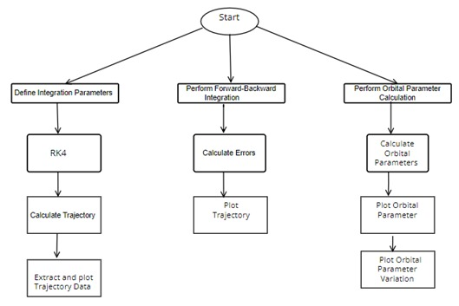

Slide 8
RESULTS & OUTPUTS
Optimized Trajectories for Asteroid Resource Mining
Composition mixture of Asteroid Minerals
Safer trajectories for Space Flights Exploration
Asteroid Collision Avoidance

Slide 9
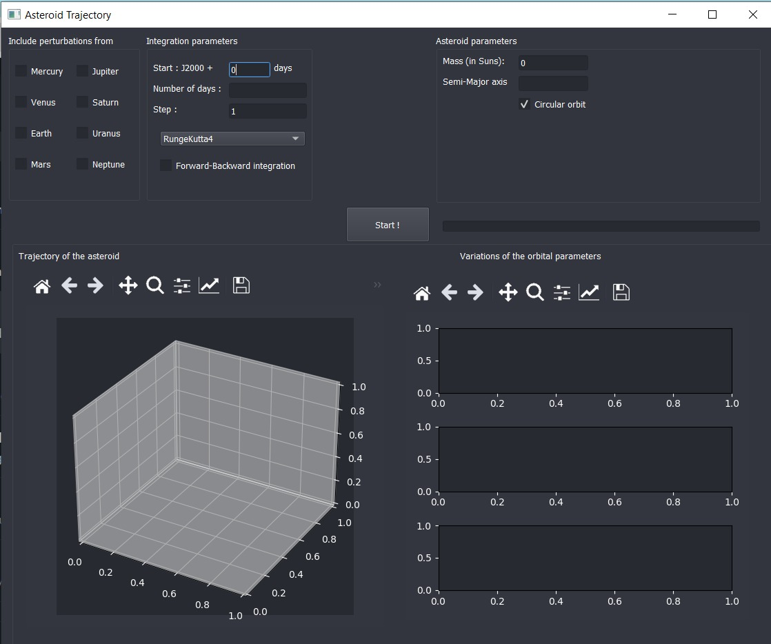
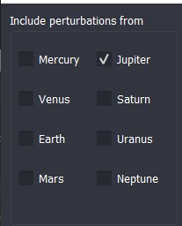
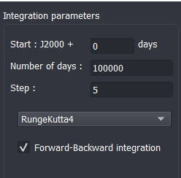

Slide 10
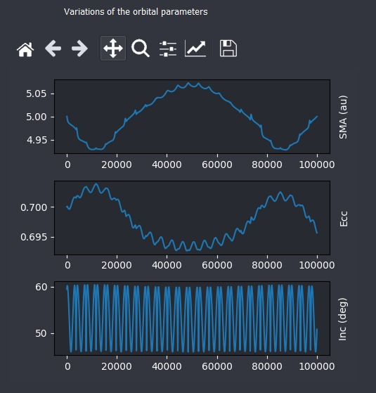
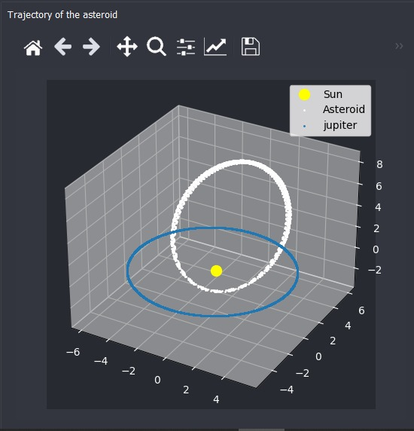

Slide 11
CONCLUSION
The field of asteroid mining and space resource utilization through the development of an integrated RK-4 Model learning.
Through a comprehensive approach encompassing
Asteroid composition analysis
Trajectory prediction
Resource extraction
Strategy optimization
Aims to address key challenges and unlock the potential of space resources for future exploration and colonization endeavors

Slide 12
FUTURE SCOPE
Spacecraft Navigation and Automation: Enhance spacecraft navigation and automation capabilities to enable autonomous mining operations,
Integration of Data Analytics: Develop integrated data analytics frameworks to combine trajectory prediction models with resource composition analysis
Innovations in Resource Characterization: Investigate novel approaches for characterizing asteroid resources, such as advanced spectroscopic techniques, remote sensing technologies

Slide 13
REFERENCES
Bate, R. R., Mueller, D. D., and White, J. E., "Fundamentals of Aerodynamics," New York, NY, 1971.
Curti, H. D., "Orbital Mechanics for Engineering Students," Burlington, MA, 2006.
Folkner, W., Williams, J., Boggs, D., The Planetary and Lunar Ephemeris DE, 421, IPN Progress Report 42-178
Hollenbeck, G., New Flight Techniques for Outer Planet Missions, AAS paper 75-087, 1975 AIAA/AAS Astrodynamics Specialist Conference
Vallado, David A. Fundamentals of Astrodynamics and Applications. 3rd ed.

Slide 14
THANK YOU

